Slide 1

Introduction to Watir
-Vishal Mishra

Slide 2


What is WATIR?
Web Application Testing In Ruby
It is a gem for the Ruby language which drives Internet Explorer the same way people do;
clicks links, fills in forms, and presses buttons.
Watir can also check results, such as whether expected text appears on the page.
It can be used to test all types of web applications (ASP.Net, JSP, PHP, Rails, etc…)
Open Source – written by Bret Pettichord, Paul Rogers and many other contributors.

Slide 3
What WATIR is not…
Watir is not a record/playback tool.
However, there are several recorders “out there”
WatirMaker
Watir WebRecorder
Webmetrics RIA Script Recorder (most recent discussion…they are considering open sourcing their application)
Watir is not a link checker
However, you can easily write your own link checker and customize it to your specific needs.
Watir is not a test case management tool.
However, you can write one in Ruby if desired.
Doesn’t test Flash or Applets.

Slide 4

What is Ruby?
Full featured Object Oriented scripting language
Made “famous” for it’s web application framework Rails. (Ruby on Rails)
Interpreted rather than compiled
Written by Matz (Yukihiro Matsumoto)
Started in 1994
Written in C
Will work on any platform that has a C compiler
Windows
Linux

Slide 5

How does Watir work?
Uses the COM interface of Internet Explorer (IE)
a.k.a ActiveX or OLE
Allows an external program to control IE
Similar interfaces exist for Word, Excel, PowerPoint and Outlook.
Full access to the contents of an HTML page
Provides different ways to access objects

Slide 6
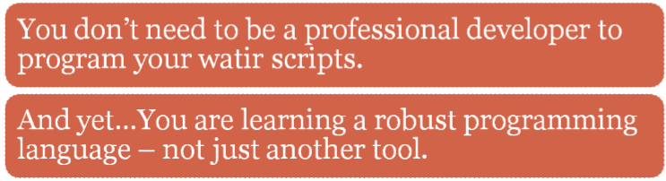


The BIG question: Why Watir

Slide 7

Why Watir cont…
As a testing tool: It’s as robust & sophisticated as ‘professional’ tools such as Rational, Mercury & Segue.
As a library of a programming language [Ruby ] : It’s powerful.
(You have the power to connect to databases, read data files, export XML, structure your code into reusable libraries, and pretty much anything else you can think of…)
No “Vendor-script”
It’s simple – elegant – INTUITIVE
It has a supportive online community for when you get ‘stuck’.

Slide 8

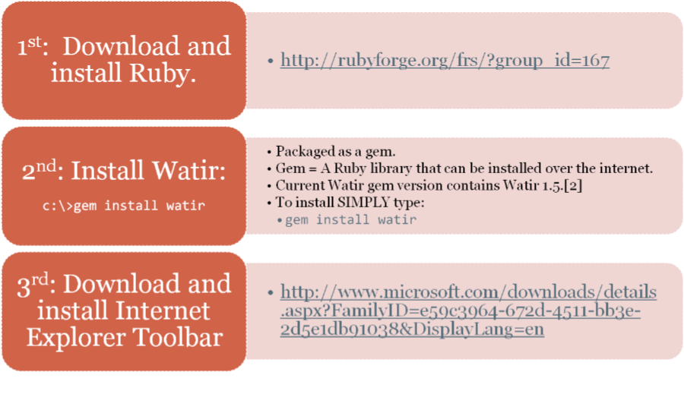
Setting up WATIR

Slide 9

Learning WATIR: Getting Started
As you start to get into Ruby/Watir you’ll want some
Good information at your fingertips!
Introductory Documentation:
Watir homepage: http://wtr.rubyforge.org
Watir User Guide: http://wiki.openqa.org/display/WTR/User+Guide
Scripting 101 Tutorial: http://wtr.rubyforge.org/s101/doc/
Books:
Everyday Scripting with Ruby: for Teams, Testers, and You: http://www.pragprog.com/titles/bmsft/
Programming Ruby (Online Book): http://www.ruby-doc.org/docs/ProgrammingRuby/

Slide 10

Learning WATIR: More In-Depth…
Forums:
Watir General Forum (now on Google Groups): http://groups.google.com/group/watir-general?hl=en
Watir Search (web interface that searches 7 Watir sites): http://www.google.com/coop/cse?cx=007267089725385613265%3Agmydx5gtw6u
“The Guts” Documentation:
Ruby Rdoc: http://wtr.rubyforge.org/rdoc/index.html
Methods Suported by Element Reference: http://wiki.openqa.org/display/WTR/Methods+supported+by+element
Online Ruby Information: http://www.ruby-doc.org/

Slide 11

Development Environments (IDE’s) for Ruby
Use any text editor as an IDE:
ScITE (Free)
Included with your ruby download.
Notepad (Free)
Eclipse (using RDT Plugin)
http://rubyeclipse.sourceforge.net/
Ruby In Steel (Free - $199) (Add-on to VS.Net )
http://www.sapphiresteel.com
Komodo IDE ($295) / Komodo Edit (Free)
http://www.activestate.com

Slide 12

Let’s get started…
It’s time to turn on the watir!

Slide 13
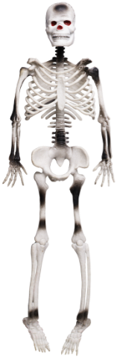
Basic Anatomy of a Watir Script
#-----------------------------------------
#All scripts should use comments
#where needed.
#-----------------------------------------
#Includes
require ‘watir’
include Watir
#Declare Variables
url = “http://www.godaddy.com”
#Open the IE Browser
browser = Watir::IE.start(url)
#Print results to the screen
Puts “Begin Test: GoDaddy”
#Logical Code / Body of Script
if browser.contains_text(“Domain Name Search”) then puts “Test PASSED”
else puts “Test FAILED”
#Close the IE Browser (clean up)
puts “End Test: GoDaddy”
browser.close

Slide 14

The Watir::IE Class
This is the heart and soul of Watir (from the users point of view)
Contains all the methods needed to create, navigate and “probe” the IE browser window
browser = Watir::IE.start(http://www.godaddy.com)
browser = Watir::IE.new
browser.attach(:url, http://www.google.com)
browser.close
browser.maximize

Slide 15

Use Watir
Using the Watir API is very easy.
Reference the Watir API using the “require” keyword and start coding
require ‘watir’
include Watir
browser = Watir::IE.start(“http://www.godaddy.com”)

Slide 16





Web Pages are all about OBJECTS
Web pages are developed with objects:
Links, buttons, tables, drop-down boxes, forms, frames, etc.
Watir scripts need to access these objects & manipulate them just as a user would.
Clicking, submitting, typing, selecting, etc…

Slide 17
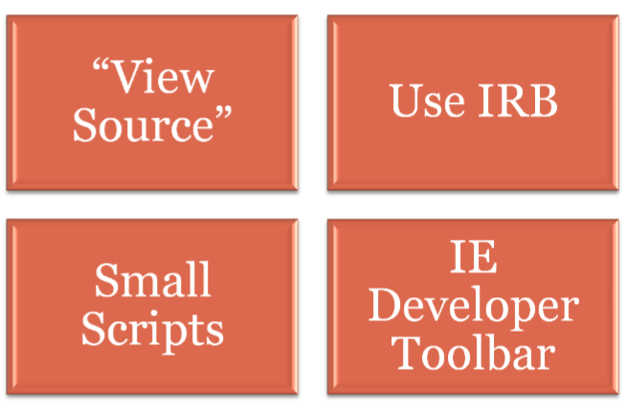

How do I identify objects?

Slide 18
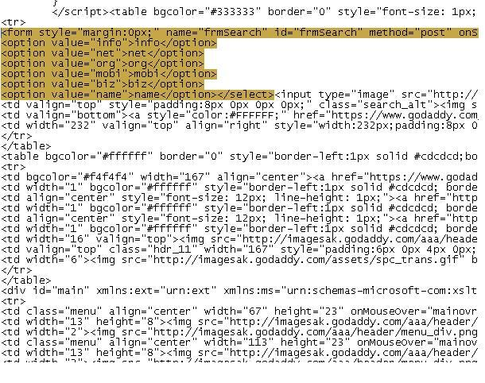
View Source
“View Source” on any page by right-clicking with your mouse on web page:

Slide 19
Small Scripts
Require ‘watir’
url = “http://www.godaddy.com“
$ie = Watir::IE.start(url)
$ie.bring_to_front
$ie.tables.each { |t| puts t.to_s} #iterate through all the tables on the page
$ie.tables[1].to_s #goto the first table on the page
$ie.tables.length #show how many tables are on the page. Tables that are
nested will be included

Slide 20
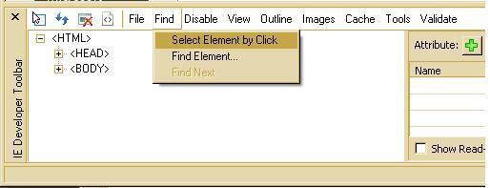
IE Developer Tool
A tool for exploring and understanding web pages.
Locates and selects specific elements on a web page by clicking on the objects in your page.
Gives a tree view of objects

Slide 21

Demo: IE Developer Toolbar
Demo: IE Developer Toolbar

Slide 22

Manipulating Objects
Now that you know how to identify objects…
The next step is how to “Manipulate” objects…

Slide 23
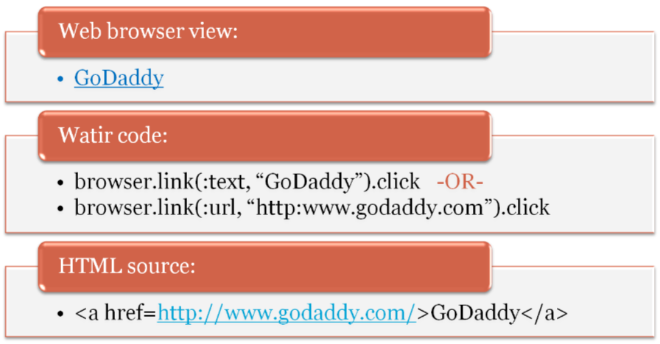

Manipulating Web Page Objects: Link

Slide 24

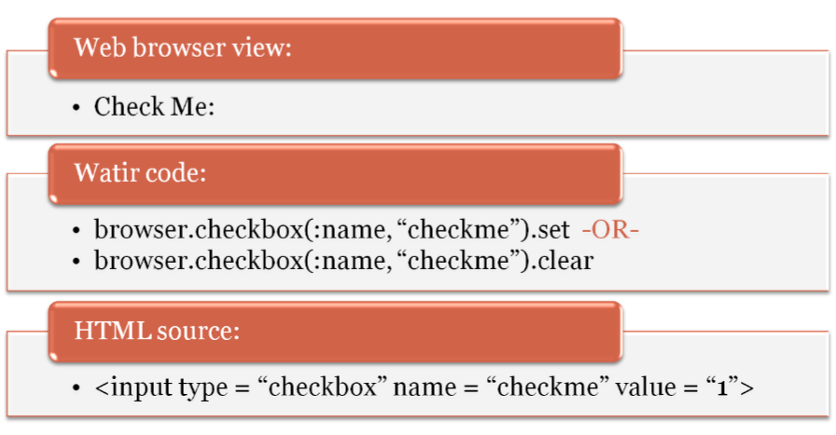

Manipulating Web Page Objects: Checkbox

Slide 25

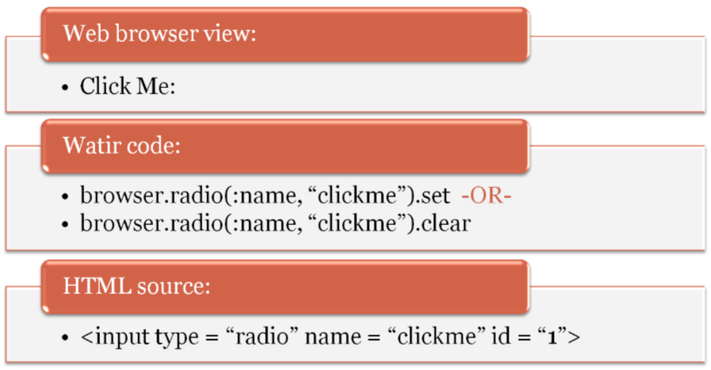
Manipulating Web Page Objects: Radio Buttons

Slide 26
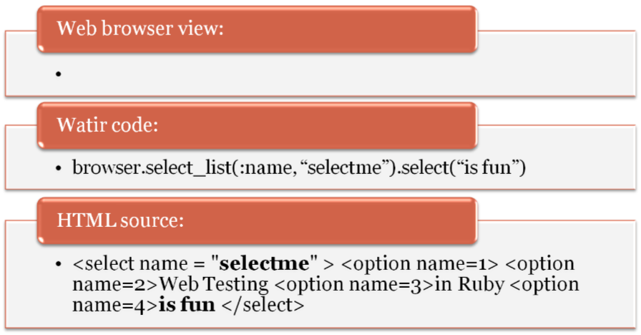

Manipulating Web Page Objects: Selection Boxes

Slide 27
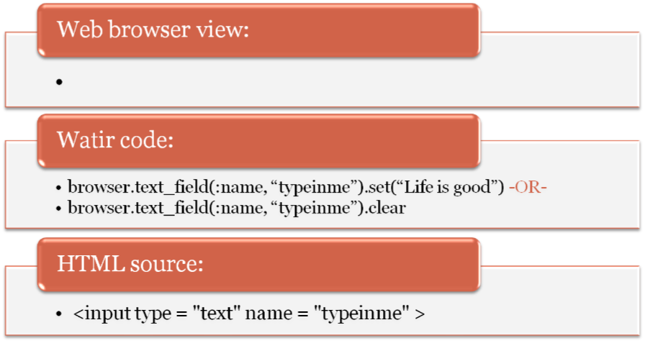

Manipulating Web Page Objects: Text Fields

Slide 28
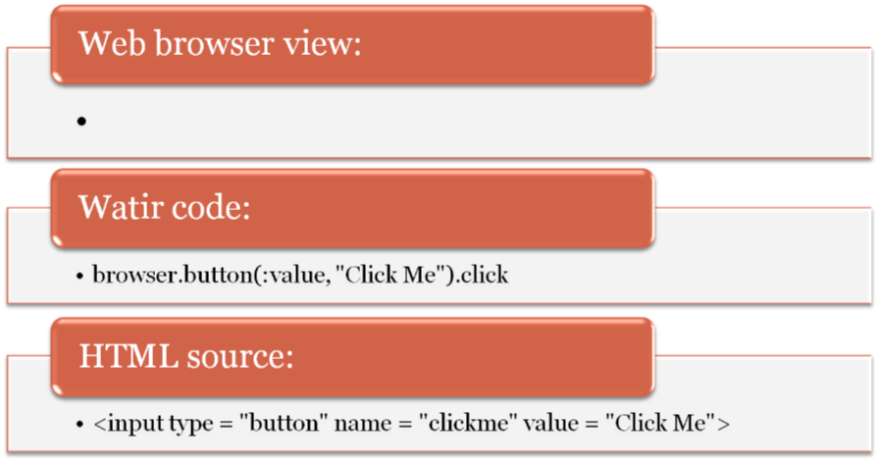

Manipulating Web Page Objects: Buttons

Slide 29


A Closer Look…at the structure
browser.button(:value, "Click Me").click
[Variable] . [method] (: [element] , “ [unique identifier]” . [method]

Slide 30


An Even Closer Look…
browser.button(:value, "Click Me").click
[Variable] . [method] (: [element] , “ [unique identifier]” . [method]

Slide 31

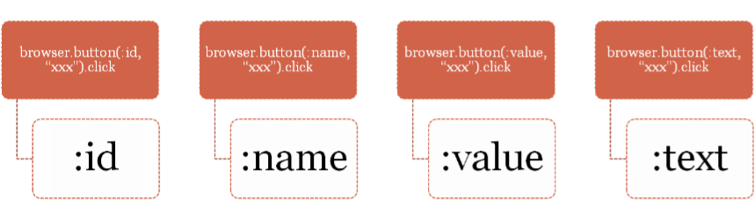
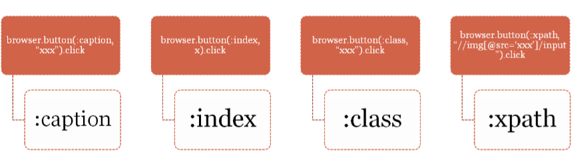
Element Options for BUTTON

Slide 32

8 elements! –But I only need one…
Even though there are 8 possible elements the user has to identify a button…
A developer might only use 1 – 3 elements in his code.
And you, as a watir scripter can only use 1 element – maybe 2 to describe your desired object.

Slide 33

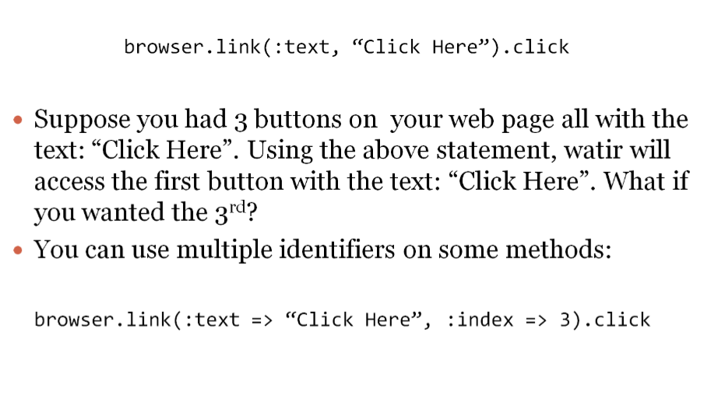


Using multiple identifiers

Slide 34
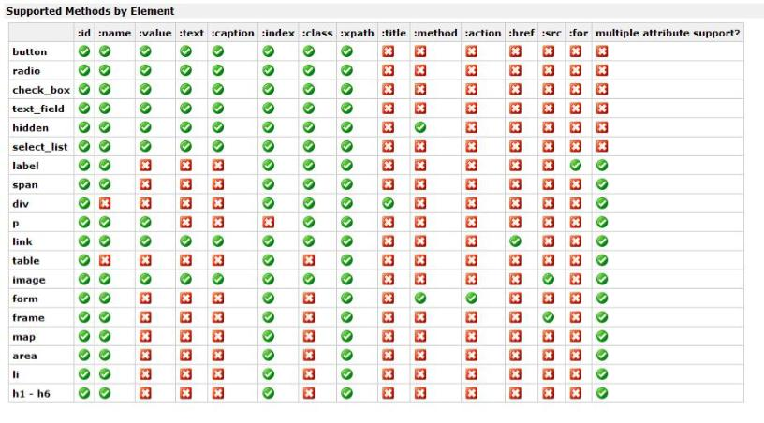
Supported methods by element
Chart obtained from: http://wiki.openqa.org/display/WTR/Methods+supported+by+element

Slide 35

Test Automation is MORE than Identifying objects
Identifying objects is currently the most time consuming part of creating your test scripts…
However, after your objects have been identified & manipulated: you want to “Test” them!
You’ll want to create “PASS” or “FAIL” scenarios.
…This is the most sophisticated part of your scripts.

Slide 36

Test::Unit
Test::Unit is a library of Ruby (just like Watir)
It is not technically part of Watir…however it is used regularly to structure tests.
To use Test::Unit in your scripts you ‘require’ it just as you do watir
require ‘test/unit’
require ‘watir’
Test::Unit is a way to organize your code into “tests”
Test::Unit has built in methods called “assertions” that help your tests with validation.
assert(browser.link(:text, “Click Here”).exists?)
The above statement will return a TRUE or FALSE indicating a pass or fail in your test.

Slide 37

Test::Unit – Basic Code Structure
require 'test/unit’
class TC_MyTest < Test::Unit::TestCase
include Watir
def setup #optional
end #optional
def teardown #optional
end #optional
def test_pass
assert(something.exists?)
end
end

Slide 38



Test::Unit–A Failure
Returns results such as these:
>ruby opf_smoketest.rb Loaded suite opf_smoketest
Started
F
Finished in 51.516 seconds.
1) Failure:
test_smokeTest(TC_manage_accounts)
[opf_smoketest.rb:35:in `create_gallery'
opf_smoketest.rb:398:in `test_smokeTest']:
<"http://app.onlinephotofiler.com/AddGallery.aspx"> expected to be =~
</app.onlinephotofiler.com\/GalleryThumbnails/>.
1 tests, 1 assertions, 1 failures, 0 errors
>Exit code: 0

Slide 39

Test::Unit–A Pass
Returns results such as these:
Loaded suite opf_smoketest
Started
01. Create Gallery - PASS
02. Add Photos - PASS
03. Edit Photos - PASS
04. Create Badge - PASS
05. Save Badge - PASS
06. Version Number - PASS
07. Reorder Galleries - PASS
08. Reorder Images - PASS
09. Edit Tags - PASS
10. Edit Title & Description - PASS
11. Create Permalinks - PASS
12. PhotoStore Make Purchase - PASS
Finished in 225.701 seconds.
1 tests, 29 assertions, 0 failures, 0 errors
>Exit code: 0

Slide 40
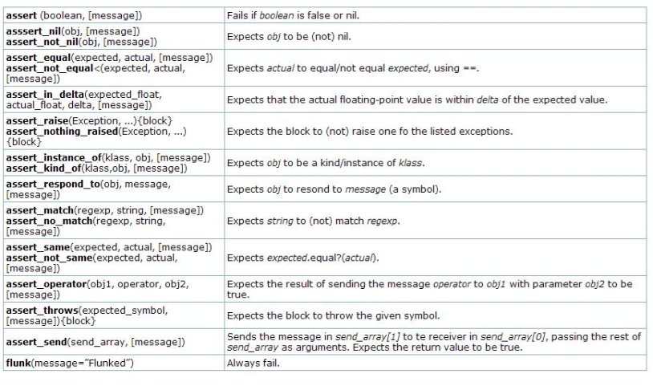
Test::Unit Assertions

Slide 41

How Test::Unit executes your tests.
It’s important to understand that Test::Unit will execute your methods in alphabetical/numerical order!
Also, the setup and teardown methods will wrap around every test. (Every methods starting with ‘test’.

Slide 42

How Test::Unit executes your tests.
If you have the following methods in a testcase using test::unit →
def setup
def teardown
def test_01 def test_02 def test_03
They will execute in this order (every test method is wrapped with the ‘setup’ and ‘teardown’ methods)
def setup def test_01 def teardown
def setup def test_02 def teardown
def setup def test_03 def teardown

Slide 43

How Test::Unit executes your tests.
To write your testcases such that you are not launching your IE browser 66x or 180x try this:
1. Use less ‘test” methods and more assertions within your methods
-OR-
2. Setup your tests like this:
def setup
def teardown
def 01 #notice these methods no longer start with ‘test’
def 02
def 03
def test_all_methods_within_one_launch_of_the_browser_and_in_this_order
01
02
03
(Compare this structure with the one on the previous page)

Slide 44

Windows Pop-Ups
Sometimes when a user is using a web page a pop-up window will appear. These require special attention in watir.
Pop-Up examples:
Security Alerts
Choose File pop-ups
Save As
Login (username/password) panels
Alert boxes
Script prompt/textbox
Confirmation Boxes (ok/cancel)

Slide 45




Windows Pop-Ups – Part 2
browser.button(:text, “Click Me”).click → change to:
browser.button(:text, “Click Me”).click_no_wait
sleep 3 #Use the sleep method with any value you need.
“.attach” method: #create a new browser instance & attach to it.
photostore_browser = Watir::IE.attach(:url, /PhotoStore/)
-OR-
Use AutoIt to manipulate windows controls

Slide 46

AutoIt
AutoIt is a scripting language designed for automating the Windows GUI
Bundled with Watir now (you don’t have to ‘require’ it)
$browser.file_field(:id, "ctl00_NonGalleryContent_Uploader1_FileUpload1").click_no_wait
sleep 2
#-------------------------------------------------------------------------------------
#AutoIt
Watir.autoit.WinWaitActive("Choose file", '', 3)
Watir.autoit.ControlSetText("Choose file", "", 1148, "1_gardengnome.jpg")
Watir.autoit.ControlClick("Choose file", "", "&Open")
#-------------------------------------------------------------------------------------

Slide 47
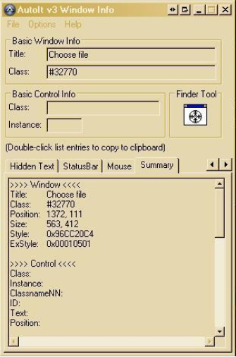

AutoIt3 Bonus!
To Read up on AutoIt3 & learn commands go here: http://www.autoitscript.com/autoit3/
AutoIt3 has an information tool (similar to the IE dev toolbar) that can help you identify windows objects. Download the full AutoIt3 program to access this tool.
AutoIt3 Download: http://www.autoitscript.com/autoit3/downloads.shtml

Slide 48
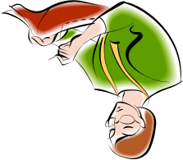
Putting it all together…
#requires
require 'watir'
require 'test/unit'
require 'test/unit/testcase'
require 'opf_navigate_to_opf_test.rb'
class TC_manage_accounts < Test::Unit::TestCase
#includes
include Watir
include Mod_navigate_to_OPF_test
#variables
$gallery_name = "Auto Gallery 17"
$version_number = "Version 2.1.1"
$storefront_url = "http://laurenssuperwondertestingsite.com/GalleryThumbnails.aspx"
$site_login = “xxxx"
$site_password = “xxxxx"
def setup
navigate_to_OPF_test
end
def teardown
$browser.close
end
def create_gallery
$browser.link(:class,"ctl00_OwnerBar1_menuGalleries_1 dropdownMenuItem ctl00_OwnerBar1_menuGalleries_5").click
$browser.text_field(:id, "ctl00_NonGalleryContent_MyPhotoGallery_mtbTitle_tbText").set($gallery_name)
$browser.button(:id, "ctl00_NonGalleryContent_lnkCreate").click
sleep 6
assert_match(/app.test.onlinephotofiler-com.ide\/GalleryThumbnails/, $browser.url.to_s)
assert($browser.div(:text, "#{$gallery_name}").exists?)
puts ("01. Create Gallery - PASS")
End
def test_smokeTest
create_gallery
End
end #End class: TC_manage_accounts

Slide 49

Congratulations! You’re on your way…
…to programming the ruby/watir way!
Notes:
Identify Objects
Manipulate
Test
***
Email
Report
Data-Driven

Slide 50

References Used 4 Presentation…
1. http://elandingstest.alaska.gov/confluence/display/IERS/Web+Application+Testing+in+Ruby+-+WATIR+Introduction
2. http://wtr.rubyforge.org/documentation.html
3. http://del.icio.us/behzad/testing
4. http://wiki.openqa.org/display/WTR/Project+Home
5. http://jrandomhacker.info/Watir
6. http://www.io.com/~wazmo/blog/archives/2007_07.html
7. http://wtr.rubyforge.org/
8. http://swik.net/Watir+Tutorial
9. http://pettichord.com/watirtutorial/reference/index.html
10. http://blog.dukk.org/files/folders/1/download.aspx
11. http://217.77.36.138/presentations/javazone/2006/slides/4499.pdf
12. http://wiki.openqa.org/display/WTR/Watir+Training+Presentation+and+Exercises
13. http://wtr.rubyforge.org/s101/doc/
14. http://members.shaw.ca/paul_rogers/presentations/Ruby_Watir_CRUSERS.pdf
…and countless others I have referenced over the years.

